Slide 1
Types of Dovetails
Disclaimer
Not how but why
Options

Slide 2
Dovetail Discussion
Partially housed, tapered mortise and tenon joint
Cousin of box joint (see drawing)
Old joint
Strong joint
Mechanical joint
Increases glue surfaces
Directional joint
Exposed vs. non-exposed
Start and end with pin or tail (?)
Symmetrical vs. Asymmetrical
Strength
Proportions (size)
Decorative
Self aligning and squaring
Sign of craftsmanship
Learning curve
Time involved
Easy to fix mistakes
Single use or variety of use
Eliminates the use of mechanical fasteners (except dowels)
Angles of dovetails
Not just furniture/cabinetmaking
Timber framing
Metal work
Masonry
Machinery

Slide 3
Angle of dovetail
Generally expressed as ratio (rise/run)– not in degrees
1:6 for softwood (9.5 degrees)
1:8 for hardwood (7.1 degrees)
1:4 for thin stock (14 degrees)
Hardwood/softwood mixed?
Old furniture vs. new dovetails
Router bits for machine cut dovetails – 7 to 14 degrees common
Marking gauges for dovetails (manufactured and shop made)
Personal preference – looks

Slide 4
Excessive Angles for Dovetails

Slide 5
Results of Excessive Angles

Slide 6
Common dovetail bits by two manufacturers.
Angle vs. depth of cut
Notice the range in the angles.
Must allow room for shank of router bit.

Slide 7
Dovetail Bevel
To find the angle draw a line square with the edge of a board and divide it into 6 or 8 parts as desired; from the end of the line and square with it, mark off a space equal to one of the divisions and set the bevel as shown.

Slide 8
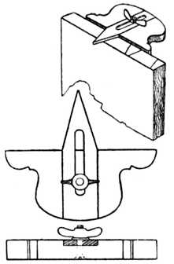
Dovetail Marker
Manufactured dovetails markers mostly cover 3 common sizes.
Shop made dovetails markers can be customized.

Slide 9
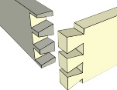
Full/Through Dovetails
Hand cut vs. machine cut vs. template cut
Directional – be aware of forces
Exposed vs. non-exposed
Thickness of wood
Species of wood (fibers)
Symmetrical vs. Asymmetrical
Number of tails – even vs. odd
Proportions of tails and pins
Size of pins
Half pin vs. half tail at top
Proud vs. flush
Undercut vs. square cut
Long grain vs. end grain glue surface
Identify Tails or Pins by looking at the face of the board.

Slide 10
Full/Through Dovetail
From Audell ‘s
Shop Manual
1923.
Dovetails are a dying art? 1902

Slide 11
Half Pin vs. Half Tail Dovetail
Strength
Location of groove for insert
Personal preference

Slide 12
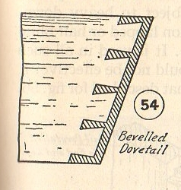
Beveled Dovetails
A full/through dovetail where one of the boards are at an angle other than a right angle.
Common on tool totes.
Use a “wedge” with marker to layout dovetails.

Slide 13
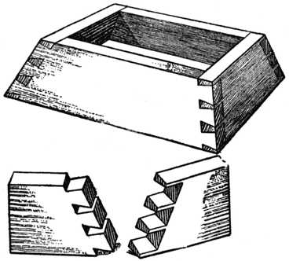
Compound Dovetail
A full/through dovetail where both of the boards are at an angle other than a right angle.
Common on serving trays.

Slide 14
Lap Dovetail
Lap joint in the shape of a dovetail.
Can be full lap or half lap dovetail
Can be blind or through
Commonly used where the top drawer rail meets the leg
Limitations?

Slide 15
Sliding Lap Dovetail
Directional
Cross grain
Half or full lap
Can be used to allow for movement

Slide 16
Bridle Dovetail
Like a bridle joint except the insert is dovetail shaped instead of rectangular.
Mortise and tenon vs. bridle joint.
Directional - only on exposed ends of boards.

Slide 17
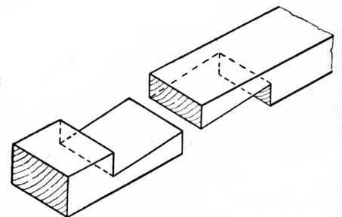
Dovetail Scarf Joint
Used in place of a butt joint.

Slide 18
Half Blind Dovetail
Joint hidden from front
Tails on side fit into sockets on front
Directionally strong
Time
Be aware of direction
Commonly used in drawers and cases

Slide 19
Full Blind/Double Lap/Secret Dovetail
Joint hidden from front and side
Also called hidden or secret dovetail joint
Molding of furniture
Veneer work?
Time
Hides joinery and craftsmanship

Slide 20
Blind Mitered Dovetail
Top pin is mitered
Same as full blind except lap is mitered
Time
Hides dovetails
Strong exposed miter joinery
Eliminates cupping
Furniture

Slide 21
Mitered Through Dovetail
Top pin or tail is mitered
Rest of dovetails are through
Common on tool chests, serving trays
Anywhere the top rail is prominent

Slide 22
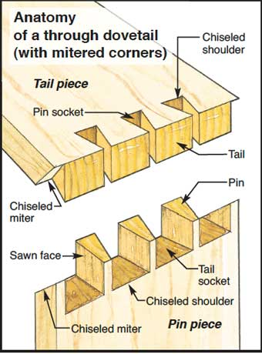
Anatomy of a Mitered Through Dovetail

Slide 23
Sliding/Housed/Tapered Dovetail
Dovetailed shaped dado
Cross grain - be aware of expansion of wood
Slides through – directional
Can be parallel or tapered
Stopped or through
Hand cut vs. template cut
Shelves and dividers

Slide 24
Half Sliding/Bareface Dovetail
One side is square and the other is dovetailed
Can be tapered
Stopped or through
Used when board is too thin for dovetails on both faces - strength
Commonly used in pigeon holes of desks and secretary

Slide 25
Diminished Dovetail
Cross between dado and sliding dovetail
Always a stop joint
Directional

Slide 26
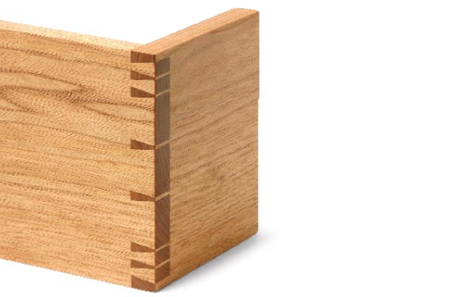
Tensioned Dovetail
Dovetails are narrow at edges and progress to wider in middle
Makes joint stronger at edges
Saves time
Looks interesting
Large chests

Slide 27
Modified Tensioned Dovetail
More artistic than functional
Stronger at ends but balanced proportions

Slide 28
Decorative Dovetail (Hounds tooth)
Many unique dovetails fit this category
Sometimes cut in an arc shape
Pins and tails can be shaped differently
Opportunity to set your own style

Slide 29
Hounds Tooth Dovetail in progress
Note small sized pins
Pins set inside dovetail
Off set at top of pin board

Slide 30
Doweled Dovetail
Dovetails for strength
Dowels are quicker and added for strength
Interesting look

Slide 31
Double Dovetail
Made famous by Incra
Through or half blind
Usually contrasting species of wood to highlight joinery
Can be cut by hand – usually with contrasting wedges installed in kerfs at joints
Decorative boxes

Slide 32
Hand Cut Double Dovetail
Hand cut
Contrasting wood to accentuate the double dovetail
Interesting look
Twice the time

Slide 33
Dovetail Keys and Splines
Align cross grain
Prevent warping and bowing
Allow cross grain movement
Reinforce joint
Decorative
Quick and easy
Boxes

Slide 34
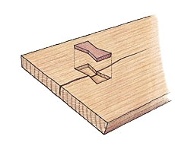
Dovetail Inlay - Dutchman
Inlay dovetail (bowtie) shaped piece of wood to hold split from opening up more
Usually contrasting piece of wood
Accentuates a flaw
Decorative

Slide 35
Other Dovetails??
Comments on other unusual dovetails?

Slide 36
You should be aware of the many different kinds of dovetails and their uses. This needs to include the strengths and weaknesses of each joint, so the next time you can determine the correct dovetail for your specific application. With knowledge, skill and experience you can alter or design your own style of dovetail joints!
Questions or Comments?
Suggestions?

